Slide 1
IBM Project
Solace- The Music You Need
(Music Website )

Slide 2
Team Members
Yash Papreja
Kartik Garg
Mansi Gupta
Mayank Thakurela
Isha Jain

Slide 3
Contents
Introduction
Features
Individual contribution

Slide 4
Introduction
Our project is a music website and is named Solace - The music you need.
Solace is a user friendly website .
It gives option to search the music you want to listen to.
It shows you the popular artists of all time.
As in when you open the website it will play the song ‘Vande Matram’ by default.

Slide 5
Features
Its features includes:
1. Playlist option
2. Last listened songs
3. Recommended songs
4. Favorite songs
5. Popular songs
6. Songs by popular artists

Slide 6
Individual contribution :
Yash: Basic layout in index.html file
Mayank: Worked on index.html and style.css
Isha: Worked on style.css
Kartik: Worked on some styling features on style.css and app.js file
Mansi: Worked on App.js file

Slide 7
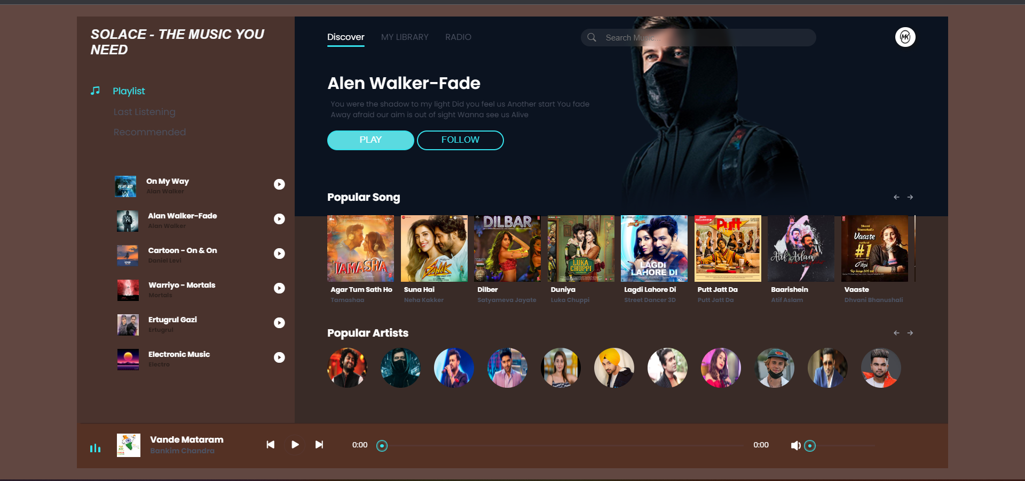
A LOOK INTO OUR WEBSITE

